Slide 1
Google Merchandise Store: Final Assignment
Louis Sherman

Slide 2
Business Questions
Where do our customers originate?
What geographical areas should we be targeting future marketing towards?
Which mobile devices and browsers are our most profitable customers using?
What are our most profitable campaigns?
Where are customers leaving the site before making purchases?

Slide 3
Summary of Terms
Metrics | Definition
Abandoned Cart Rate | The rate at which customers add products to their cart but choose not to complete the purchase.
Bounce Rate | The rate at which customers leave the website after only viewing one page.
Channel | Collection of referrers (organic search, paid search, etc.).
Cost-per-click (CPC) | The average cost you paid for each click on your search ad
Ecommerce conversion rate | The rate at which customers choose to make a purchase on the ecommerce site.
Exit Page | The last page users viewed before they exited the site.
Landing Page | The page where users first landed when they came to the site.
Page value | The average value of this page or set of pages. (Transaction Revenue + Total Goal Value)/Unique Pageviews
Revenue per user | The money generated from customers by purchasing goods or services within a given period
Source | The specific referrer that brought a user to the site.
Unique Pageviews | Pageviews that are generated by the same user during the same session. Represents the number of sessions during which that page was viewed one or more times.

Slide 4
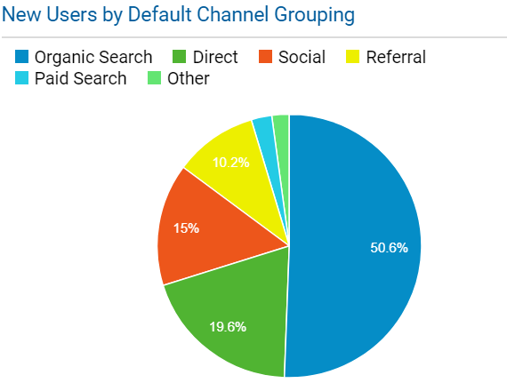
Acquisition: Where Do Our Customers Originate?
Organic Searches provide us with most of our new users
Social and Affiliate Channels have above average bounce rates with low revenue per user
Referrals provide us with our most profitable users, who have the lowest bounce rate

Slide 5
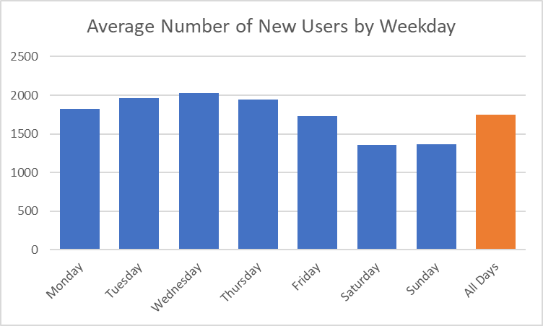
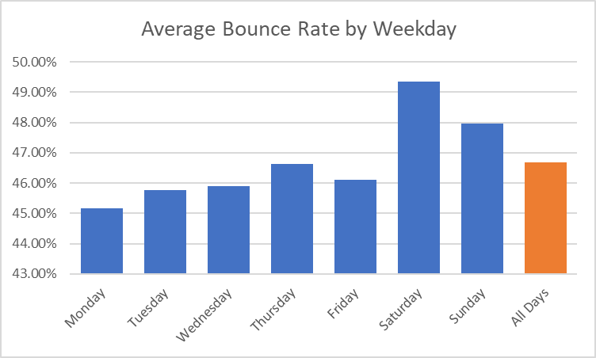
Acquisition: Where Do Our Customers Originate?
Weekly seasonality of new users to the store exists
Weekends (Friday – Sunday) - Bounce rates are high and the number of new users are low
Average Bounce Rate – 46.7%

Slide 6
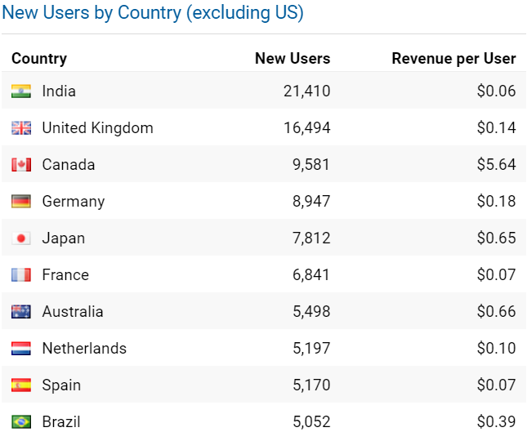
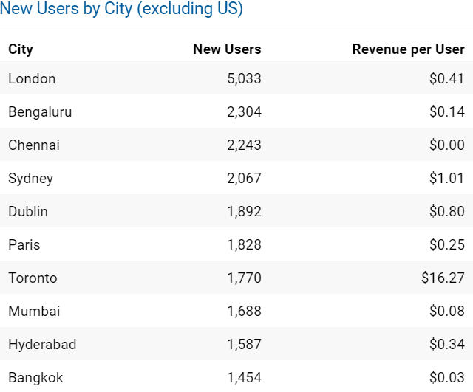
Behavior: Which geographical areas should we target? (International)
India has been the most popular Country for new users. Canada has been the most profitable per user.
London, UK has been the most popular city for new users. Toronto, CA has been the most profitable per user.

Slide 7
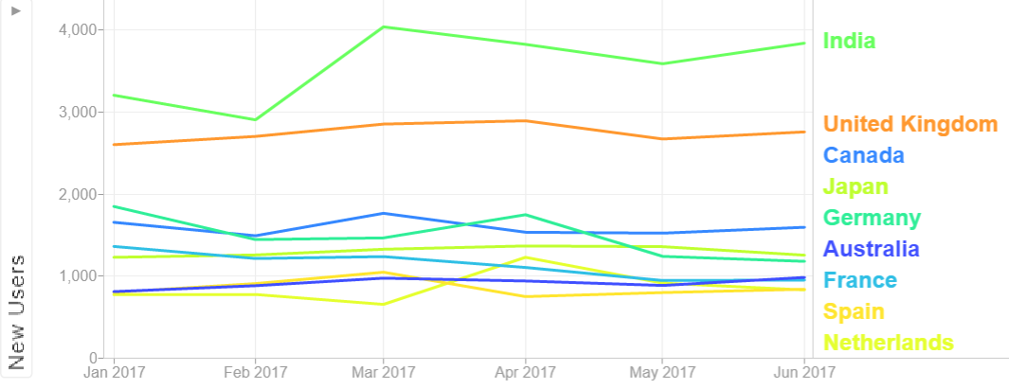
Behavior: Which geographical areas should we target? (Countries)

Slide 8
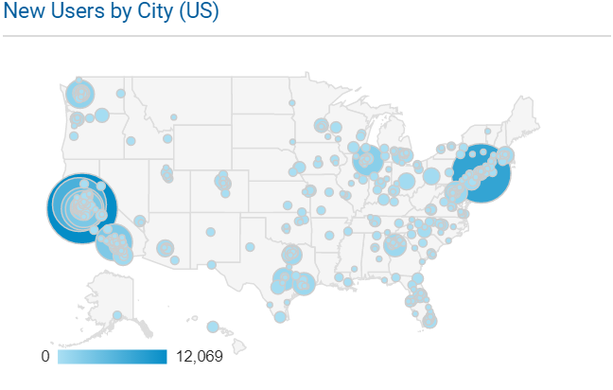
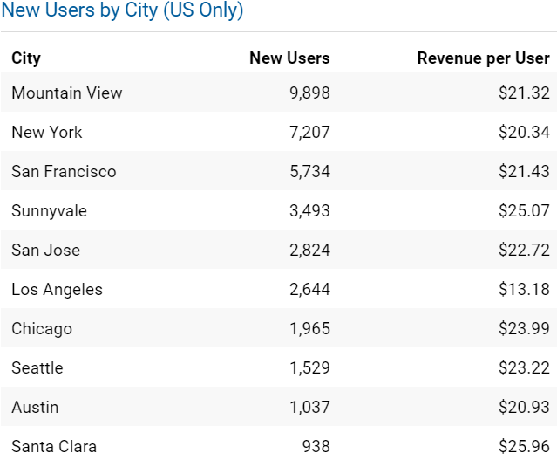
Behavior: Which geographical areas should we target? (Domestic)
Mountain View, CA has been the most popular city
Los Angeles, CA has room for improvement
Sunnyvale, CA and Santa Clara, CA have been the most profitable per new user

Slide 9
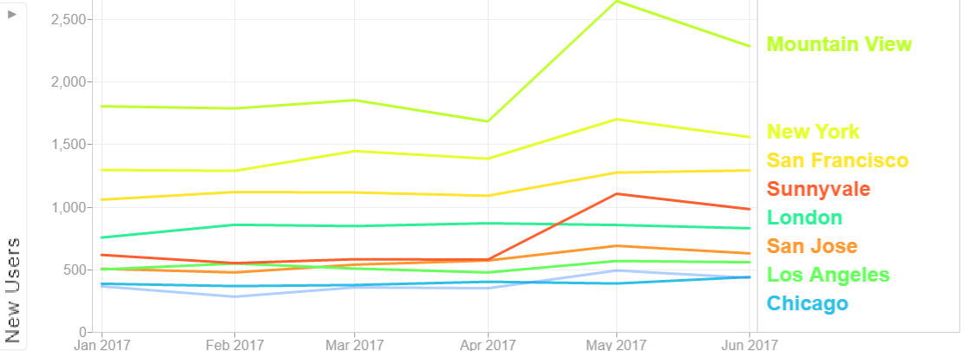
Behavior: Which geographical areas should we target? (Cities)

Slide 10
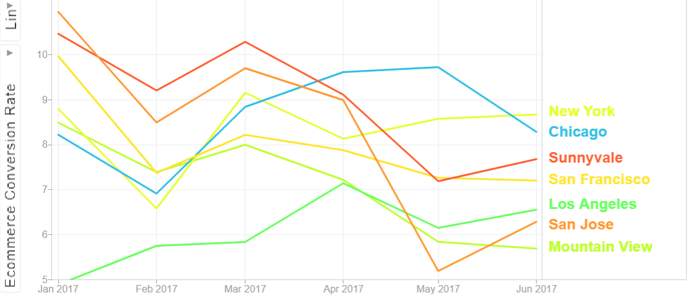
Behavior: Which geographical areas should we target? (Cities)

Slide 11
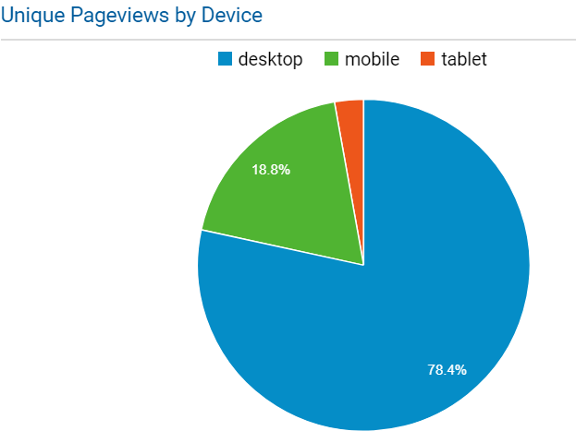
Behavior: Which mobile devices and browsers are our most profitable customers using?
Desktop has the most pageviews, lowest bounce rate, highest conversion rate, and highest revenue per user
Mobile has 6x pageviews as tablets but similar revenue per user and conversion rate

Slide 12
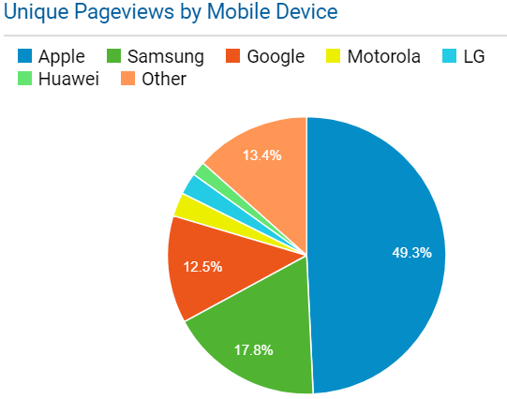
Behavior: Which mobile devices and browsers are our most profitable customers using?
Apple has the most pageviews and shortest load time
Google has the highest page value and conversion rate
Google has the lowest bounce rate, Huawei has the highest

Slide 13
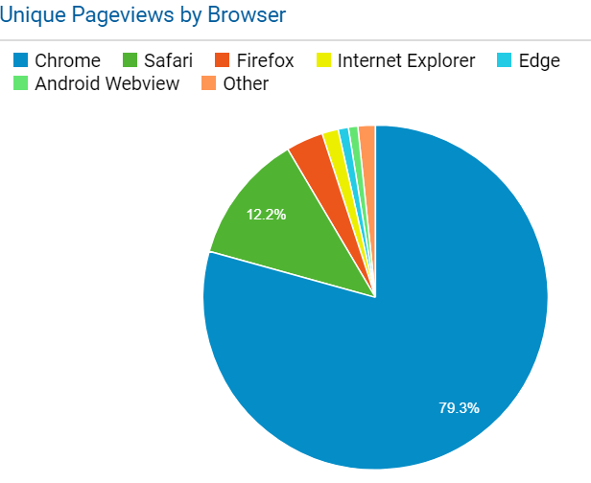
Behavior: Which mobile devices and browsers are our most profitable customers using?
Chrome is the most used browser, has the lowest bounce rate, and the highest conversion rate
With a low sample size, Firefox has the highest page value of all broswers

Slide 14
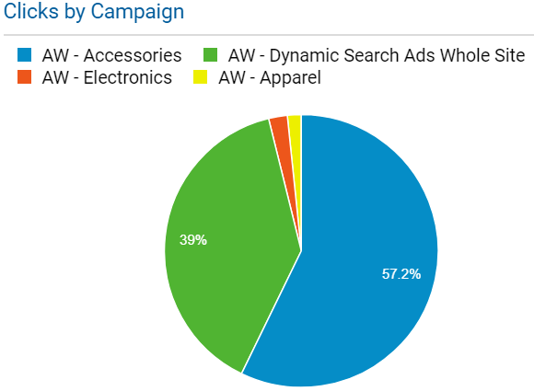
Conversion: What are Our Most Profitable Campaigns?
Accessories is the most clicked & profitable campaign
Electronics has the highest cost-per-click (CPC)
Apparel has a low CPC and our highest conversion rate

Slide 15
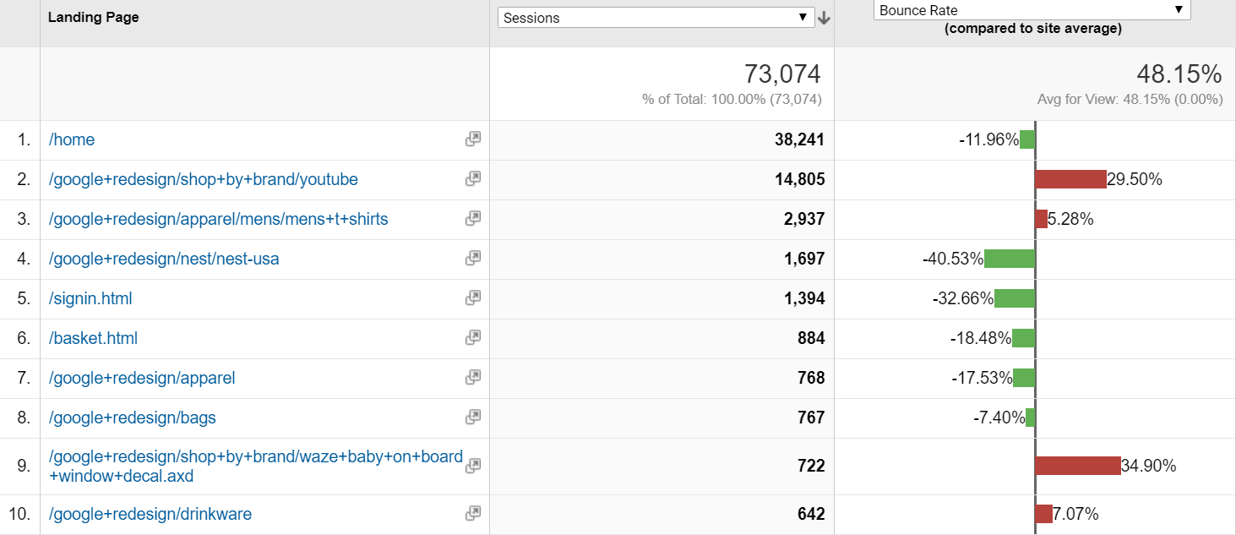
Conversion: Where are customers leaving the site before making purchases?
Landing Pages

Slide 16
Conversion: Where are customers leaving the site before making purchases?
Exit Pages

Slide 17
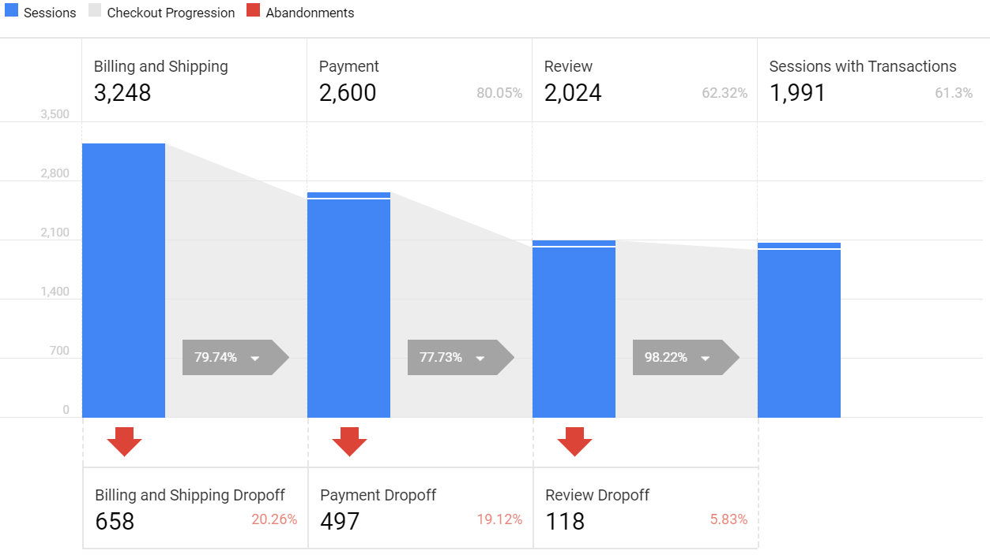
Conversion: Where are customers leaving the site before making purchases?
Abandonments

Slide 18
Conversion: Where are customers leaving the site before making purchases?
Abandonments

Slide 19
Recommendations
An increase in weekend deals and advertising
Marketing expansion should be increased in Canada due to its close vicinity to the US
Add more to the Apparel AdWords budget, remove investing in Electronics campaign
Advertising on Chrome and on Apple devices will reach the largest audience
The YouTube landing page is showing a high bounce rate and may need a re-evaluation
Abandonment rates are high in our international markets. London, Sydney and Chennai all have abandonment rates above 75% at the Billing and Shipping page

Slide 20
References
“Google Merchandising Store Demo Account.” Google Analytics. 24 March 2017. Retrieved from:https://analytics.google.com/analytics/web/?utm_source=demoaccount&ut m_medium=demoaccount&utm_campaign=demoaccount#report/visitors- overview/a54516992w87479473p92320289/%3Foverview- graphOptions.selected%3Danalytics.nthMonth/

